Slide 1
Recurrent Neural Networks
성균관대학교 소프트웨어학과
이 지 형

Slide 2
Contents
Recurrent Neural Networks
Long Short-Term Memory (LSTM)
Attention Model

Slide 3
Sequential Data Modeling
Sequential Data
Most of data are sequential
Speech, Text, Image, …
Deep Learnings for Sequential Data
Convolutional Neural Networks (CNN)
Try to find local features from a sequence
Recurrent Neural Networks: LSTM, GLU
Try to capture the feature of the past

Slide 4
Sequential Data Modeling
Three Types of Problems
Next Step Prediction
Classification
Sequence Generation
Sequence
Model
A B C D E
F
Sequence
Model
A B C D E
Good/Bad
Sequence
Model
A B C D E
1 2 3 4 5 6 7

Slide 5

Sequential Data Modeling
Sequence Generation
Machine Translation
Speech Recognition
Image Caption Generation
This is a very good wine
C’est un très bon vin
This is a very good wine
A bird is flying

Slide 6
Recurrent Neural Networks
Connections form cycles
x₁
h₁
o₁
x₂
h₂
o₂
…
…
…
x_{m}
h_{k}
o_{n}
c₁
c₂
…
c_{k}

Slide 7
Recurrent Neural Networks
Connections form cycles
x₁
h₁
o₁
x₂
h₂
o₂
…
…
…
x_{m}
h_{k}
o_{n}
c₁
c₂
…
c_{k}

Slide 8
Recurrent Neural Networks
Connections form cycles
x₁
h₁
o₁
x₂
h₂
o₂
…
…
…
x_{m}
h_{k}
o_{n}
c₁
c₂
…
c_{k}

Slide 9
Recurrent Neural Networks
Connections form cycles
x₁
h₁
o₁
x₂
h₂
o₂
…
…
…
x_{m}
h_{k}
o_{n}
c₁
c₂
…
c_{k}

Slide 10
Recurrent Neural Networks
Connections form cycles
x₁
h₁
o₁
x₂
h₂
o₂
…
…
…
x_{m}
h_{k}
o_{n}
c₁
c₂
…
c_{k}

Slide 11
Recurrent Neural Networks
Connections form cycles
x₁
h₁
o₁
x₂
h₂
o₂
…
…
…
x_{m}
h_{k}
o_{n}
c₁
c₂
…
c_{k}

Slide 12
Recurrent Neural Networks
Connections form cycles
x₁
h₁
o₁
x₂
h₂
o₂
…
…
…
x_{m}
h_{k}
o_{n}
c₁
c₂
…
c_{k}

Slide 13
Recurrent Neural Networks
Connections form cycles
x₁
h₁
o₁
x₂
h₂
o₂
…
…
…
x_{m}
h_{k}
o_{n}
c₁
c₂
…
c_{k}

Slide 14
Recurrent Neural Networks
Connections form cycles
x₁
h₁
o₁
x₂
h₂
o₂
…
…
…
x_{m}
h_{k}
o_{n}
c₁
x_{t}
h_{t}
o_{t}
c₂
…
h_{t-1}
c_{k}

Slide 15





Recurrent Neural Networks
Connections form cycles
𝒙_{𝒕}: input at time 𝒕
h_{𝒕}: hidden state at time 𝒕
𝒇: is an activation function
U, V, W: network parameters
RNN shares the same parameters across all time steps
g: activation function for the output layer
o_{t}
$$V$$
$$W$$
$$h_{t}=f\left(Ux_{t}+Wh_{t−1}\right)$$
h_{t-1}
h_{t}
$$\left.o_{t}=g(Vh_{t}\right)$$
$$U$$
x_{t}

Slide 16
Recurrent Neural Networks
Connections form cycles
o_{t}
$$V$$
$$W$$
$$h_{t}=f\left(Ux_{t}+Wh_{t−1}\right)$$
h_{t-1}
h_{t}
$$\left.o_{t}=g(Vh_{t}\right)$$
$$U$$
x_{t}
x₁
x₂
x₃
x₄
x₅

Slide 17
Recurrent Neural Networks
Connections form cycles
o_{t}
$$V$$
$$W$$
$$h_{t}=f\left(Ux_{t}+Wh_{t−1}\right)$$
h_{t-1}
h_{t}
$$\left.o_{t}=g(Vh_{t}\right)$$
$$U$$
x_{t}
o₁
h₁
x₁
x₂
x₃
x₄
x₅

Slide 18
Recurrent Neural Networks
Connections form cycles
o_{t}
$$V$$
$$W$$
$$h_{t}=f\left(Ux_{t}+Wh_{t−1}\right)$$
h_{t-1}
h_{t}
$$\left.o_{t}=g(Vh_{t}\right)$$
$$U$$
x_{t}
o₁
o₂
h₁
h₂
x₁
x₂
x₃
x₄
x₅

Slide 19
Recurrent Neural Networks
Connections form cycles
o_{t}
$$V$$
$$W$$
$$h_{t}=f\left(Ux_{t}+Wh_{t−1}\right)$$
h_{t-1}
h_{t}
$$\left.o_{t}=g(Vh_{t}\right)$$
$$U$$
x_{t}
o₁
o₂
o₃
h₂
h₃
x₁
x₂
x₃
x₄
x₅

Slide 20
Recurrent Neural Networks
Connections form cycles
o_{t}
$$V$$
$$W$$
$$h_{t}=f\left(Ux_{t}+Wh_{t−1}\right)$$
h_{t-1}
h_{t}
$$\left.o_{t}=g(Vh_{t}\right)$$
$$U$$
x_{t}
o₁
o₂
o₃
o₄
h₃
h₄
x₁
x₂
x₃
x₄
x₅

Slide 21
Recurrent Neural Networks
Connections form cycles
o_{t}
$$V$$
$$W$$
$$h_{t}=f\left(Ux_{t}+Wh_{t−1}\right)$$
h_{t-1}
h_{t}
$$\left.o_{t}=g(Vh_{t}\right)$$
$$U$$
x_{t}
o₁
o₂
o₃
o₄
o₅
h₄
h₅
x₁
x₂
x₃
x₄
x₅

Slide 22
Recurrent Neural Networks
Connections form cycles
o_{t}
$$V$$
$$W$$
$$h_{t}=f\left(Ux_{t}+Wh_{t−1}\right)$$
h_{t-1}
h_{t}
$$\left.o_{t}=g(Vh_{t}\right)$$
$$U$$
x_{t}
o₁
o₂
o₃
o₄
o₅
h₁
h₂
h₃
h₄
h₅
x₁
x₂
x₃
x₄
x₅

Slide 23
Recurrent Neural Networks
Long Term Dependency
x₁~x_{t-1} are encoded into h_{t-1}
h_{t-1} has the information on the past
It is a context to process x_{t}
o₅
h₁
h₂
h₃
h₄
h₅
x₁
x₂
x₃
x₄
x₅

Slide 24




Recurrent Neural Networks
Long Term Dependency of Standard RNN
However, it may exponentially decade or grow
Usually it is limited to 10 steps
o₁
o₂
o₃
o₄
o₅
$$W$$
$$W$$
$$W$$
$$W$$
h₁
h₂
h₃
h₄
h₅
x₁
x₂
x₃
x₄
x₅

Slide 25
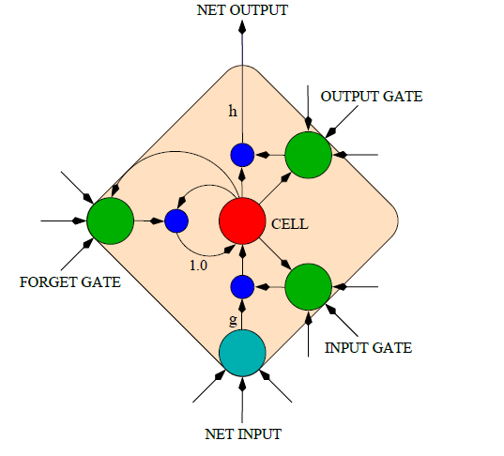
Long Short-Term Memory (LSTM)
Capable of learning long-term dependencies.
LSTM networks introduce a new structure called a memory cell
An LSTM can learn to bridge time intervals in excess of 1000 steps
Gate units that learn to open and close access to the past
Input gate
Forget gate
Output gate
Neuron with a self-recurrent

Slide 26
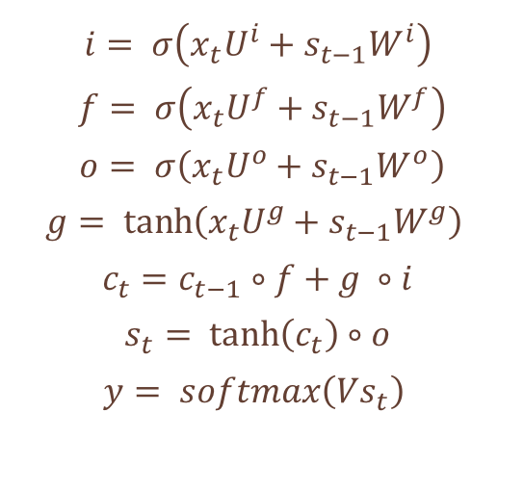
Long Short-Term Memory (LSTM)
Equations
𝒊: input gate to accept the new
𝒇: forget gate to forget the past
𝒐: output gate, how much of the information will be passed to expose to the next time step.
𝒈: self-recurrent which is equal to standard RNN
𝒄_{𝒕}: internal memory
𝒔_{𝒕}: hidden state
𝐲: final output
$$i= σ\left(x_{t}U^{i}+s_{t−1}W^{i}\right)$$
$$f= σ\left(x_{t}U^{f}+s_{t−1}W^{f}\right)$$
$$o= σ\left(x_{t}U^{o}+s_{t−1}W^{o}\right)$$
$$g= \tanh\left(x_{t}U^{g}+s_{t−1}W^{g}\right)$$
$$c_{t}=c_{t−1}∘f+g ∘i$$
$$s_{t}= \tanh\left(c_{t}\right)∘o$$
$$y= softmax\left(Vs_{t}\right)$$

Slide 27



Long Short-Term Memory (LSTM)
o_{t}
$$V$$
How to work
$$W$$
h_{t-1}
h_{t}
$$U$$
x_{t}
h_{t-1}
h_{t}
x_{t}
y_{t}

Slide 28
Long Short-Term Memory (LSTM)
o_{t}
$$V$$
How to work
$$W$$
h_{t-1}
h_{t}
$$U$$
x_{t}
c_{t-1}
c_{t}
h_{t-1}
h_{t}
x_{t}
y_{t}

Slide 29
Long Short-Term Memory (LSTM)
o_{t}
$$V$$
How to work
$$W$$
h_{t-1}
h_{t}
$$U$$
x_{t}
c_{t-1}
+
c_{t}
tanh
g_{t}
h_{t-1}
h_{t}
x_{t}
y_{t}

Slide 30
Long Short-Term Memory (LSTM)
o_{t}
$$V$$
How to work
$$W$$
h_{t-1}
h_{t}
$$U$$
x_{t}
c_{t-1}
*
+
c_{t}
tanh
f_{t}
g_{t}
h_{t-1}
h_{t}
x_{t}
y_{t}

Slide 31
Long Short-Term Memory (LSTM)
o_{t}
$$V$$
How to work
$$W$$
h_{t-1}
h_{t}
$$U$$
x_{t}
c_{t-1}
*
+
c_{t}
tanh
*
f_{t}
g_{t}
i_{t}
h_{t-1}
h_{t}
x_{t}
y_{t}

Slide 32
Long Short-Term Memory (LSTM)
o_{t}
$$V$$
How to work
$$W$$
h_{t-1}
h_{t}
where is the logistic sigmoid function, and i, f,
o and c are the input gate, forget gate, output gate
and cell vectors, all of which are the same size as
the hidden vector h
$$U$$
x_{t}
c_{t-1}
*
+
c_{t}
tanh
*
f_{t}
g_{t}
i_{t}
o_{t}
*
h_{t-1}
h_{t}
x_{t}
y_{t}

Slide 33
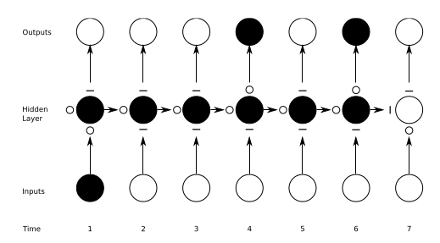
Long Short-Term Memory (LSTM)
Preserving Sequence Information
O : entirely open
— : entirely closed
Traditional RNNs are a special case of LSTMs:
Input gate set to 1 (passing all new information)
Forget gate set to 0 (forgetting all of the past)
Output gate set 1 (exposing the entire memory)

Slide 34
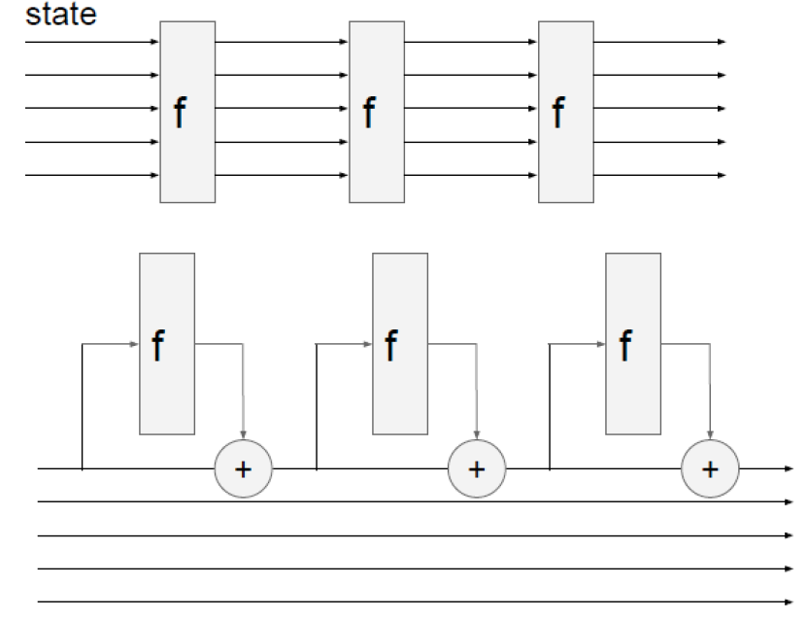
Long Short-Term Memory (LSTM)
RNN vs LSTM
RNN
LSTM

Slide 35
Long Short-Term Memory (LSTM)
Gradient Flow
Backpropagation from c_{t} to c_{t-1} only elementwise multiplication by f, no matrix multiply by W
c_{t-1}
*
+
c_{t}
tanh
*
f_{t}
g_{t}
i_{t}
o_{t}
*
h_{t-1}
h_{t}
x_{t}
y_{t}

Slide 36
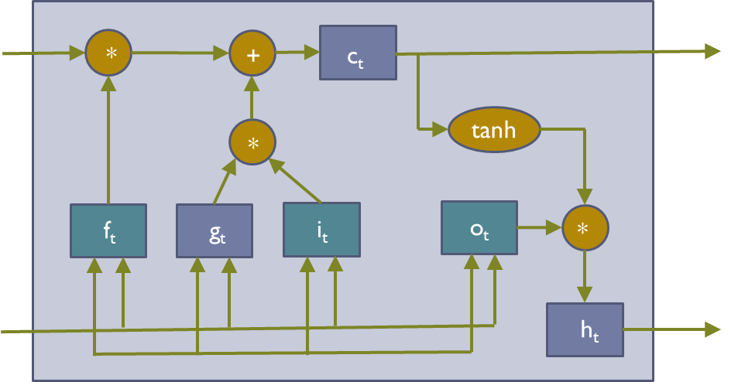
Long Short-Term Memory (LSTM)
Gradient Flow
C₀
C₁
C₂
C₃
h₀
h₁
h₂
h₃

Slide 37
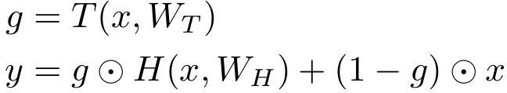
Long Short-Term Memory (LSTM)
Gradient Flow
Uninterrupted Gradient Flow
C₀
C₁
C₂
C₃
h₀
h₁
h₂
h₃
In between:
Highway Networks
Similar to ResNet!
3x3 conv, 128
3x3 conv, 128
3x3 conv, 128
3x3 conv, 128
3x3 conv, 128
3x3 conv, 128 / 2
3x3 conv, 64
3x3 conv, 64
3x3 conv, 64
3x3 conv, 64
3x3 conv, 64
3x3 conv, 64
Pool
7x7 conv, 64 / 2 Input
Softmax FC 1000
Pool
3x3 conv, 64
3x3 conv, 64
3x3 conv, 64
3x3 conv, 64
3x3 conv, 64
3x3 conv, 64
...
Srivastava et al, “Highway Networks”, ICML DL Workshop 2015

Slide 38
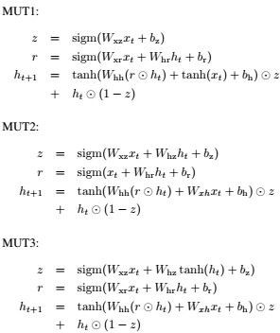
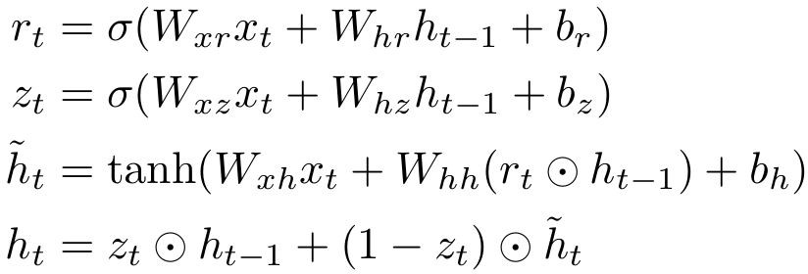
Other Variants
GRU

Slide 39
Question and Answer

